Slide 1
Land Use Crop Classification Using Sentinel data
Ana Wegman
02/21/2018

Slide 2
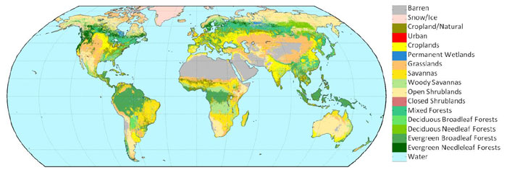
0.5 km MODIS-based Global Land Cover Climatology, USGS
Notes:
What is a Land Use Classification? Assigning to every pixel the land use class that belong to
I want to do this but focused on the CROPS, so say where there is Agriculture, Which is the crop grown for a specific season in an intensively agricultural area in California. This is hard because…
Why? Having this information is useful for Agriculture resources monitoring, Crop production/Food supply safety, Crop rotations, Crop yield assessment, Precision Agriculture, Use of chemical applications, Water need / irrigation systems, Climate change resilience, To inform policy makers and governments

Slide 3
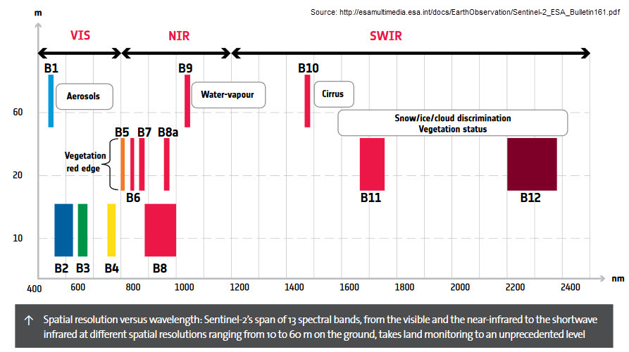
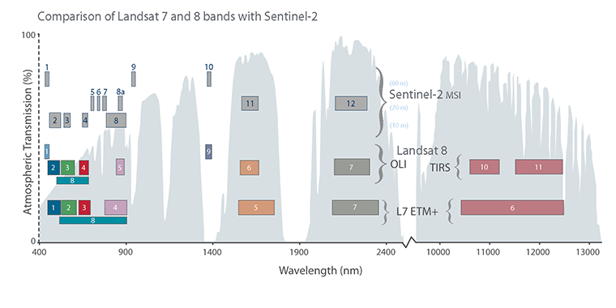
Sentinel 2 Data
Notes:
Very similar to Landsat BUT it has 3 bands in the red-edge area of the spectrum which can give us more information related to crops, and more spatial resolution (10 and 20 m vs 30) and more temporal resolution (5 d vs 16 d)

Slide 4
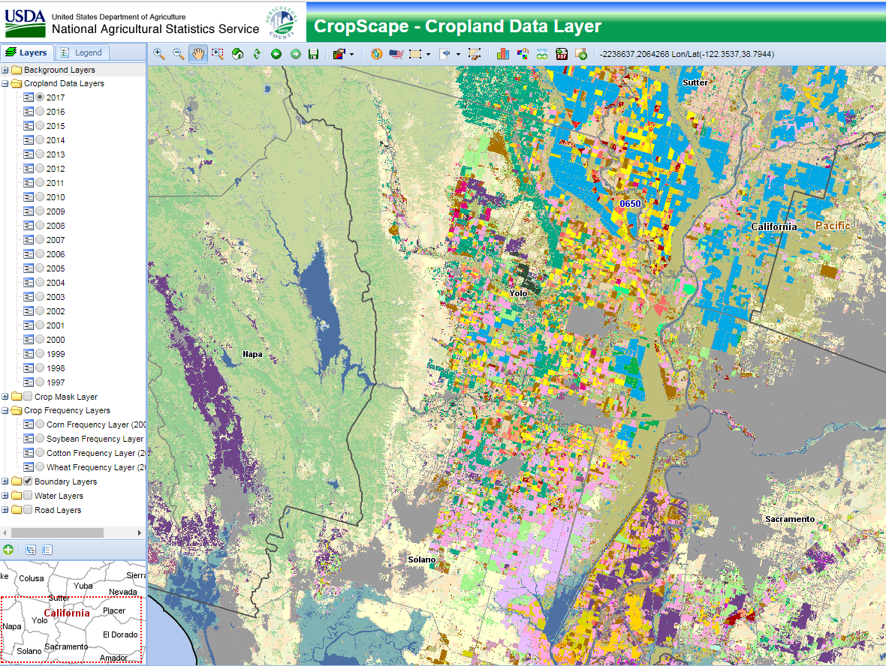
Method
OID | Crop
1 | Grain and Hay Crops/Summer Fallow
2 | Rice
3 | Safflower
4 | Corn
5 | Sunflower
6 | Alfalfa
7 | Pasture
8 | Grass
9 | Cucurbit
10 | Potatoes
11 | Tomatoes
12 | Bush Berries
13 | Truck Crops
14 | Cherries
15 | Pears
16 | Almonds
17 | Walnuts
18 | Pistachios
19 | Other Deciduous
20 | Olives
21 | Vineyards
22 | Non-ag vegetation
23 | Urban
24 | Water
25 | Semi-agricultural/ROW
26 | Forest
27 | Other non-ag vegetation
28 | Other ag vegetation
Notes:
Method: Supervised Classification called Support Vector Machine. It uses the spectral signature defined in the training set for each class and then predicts for a given test sample statistically what class fits better Training Dataset: Agreement between the CropScape and a Land Use Crop Classification prepared by a private consultant, both 30 mts resolution
Software R, specifically caret package

Slide 5
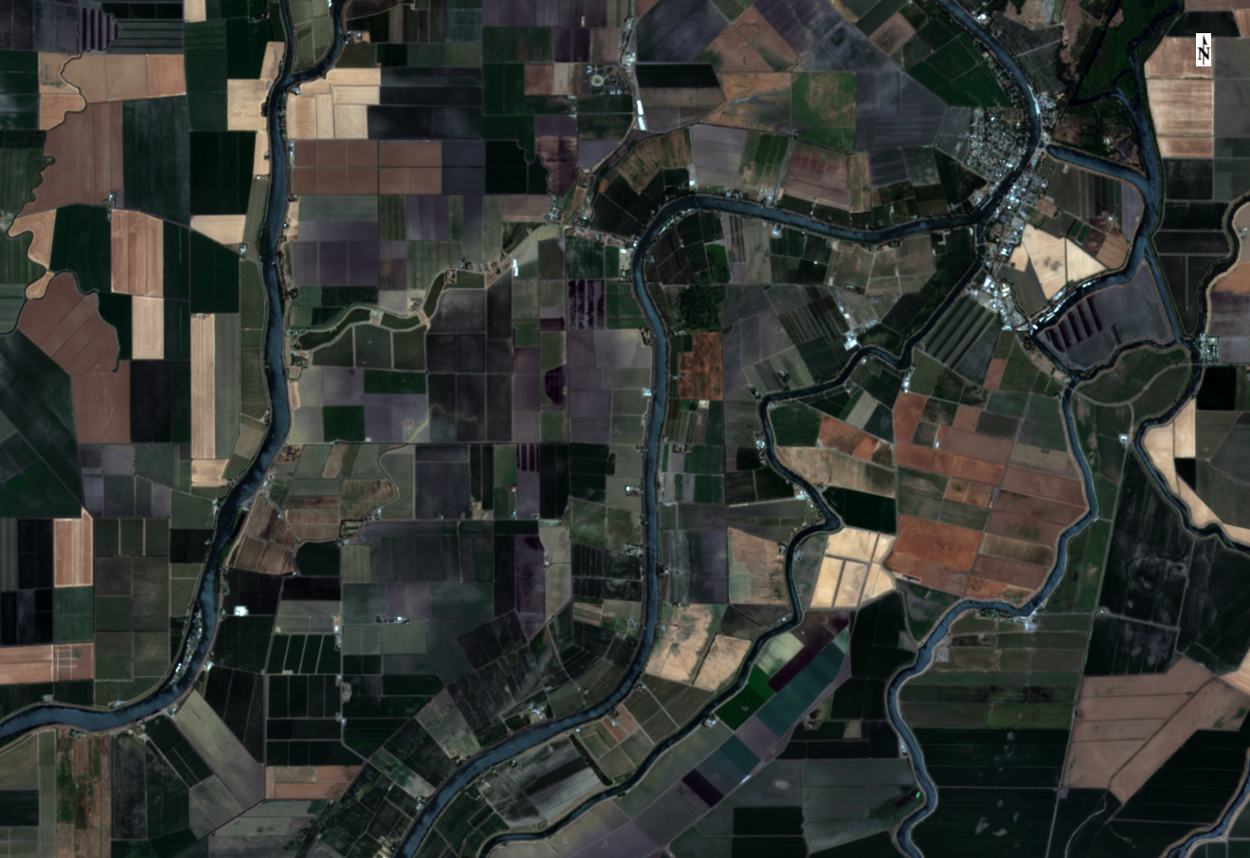
Questions?

